Slide 1
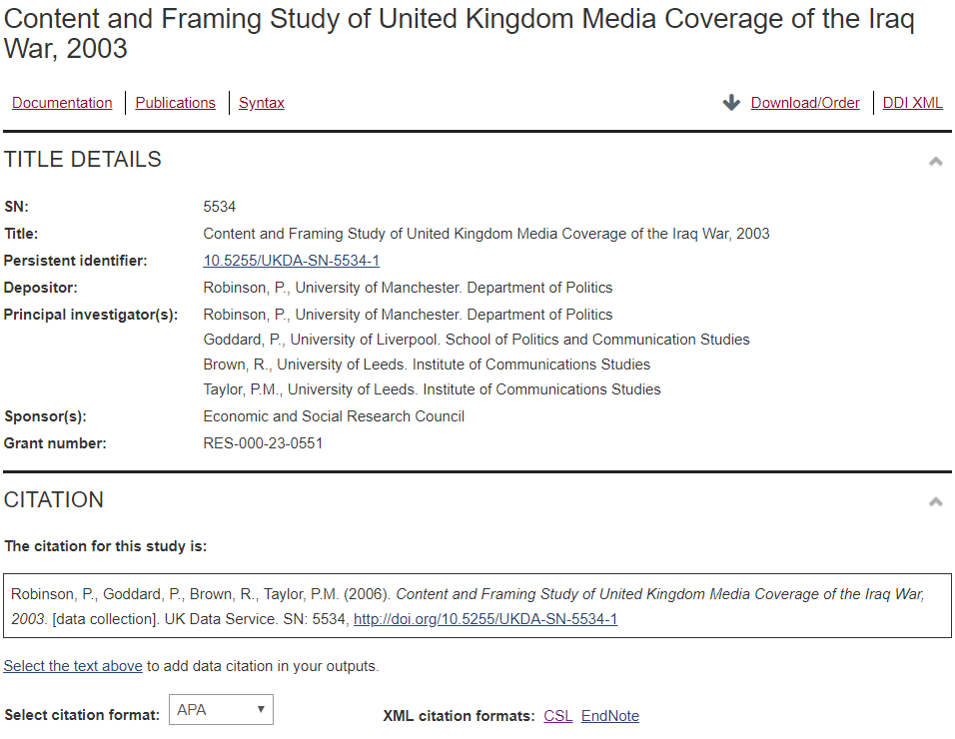
Initial Proposal
Notes:
Briefly explain data set and what I would do
Problem with data set (say I considered this in proposal)

Slide 2
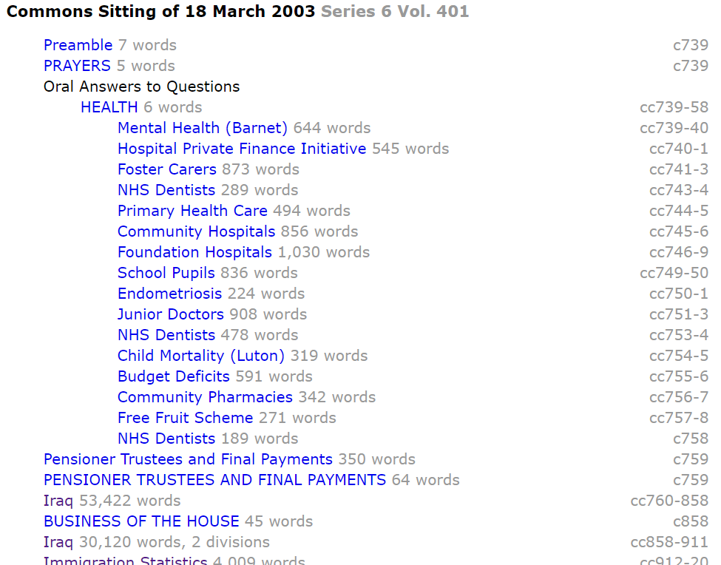
Revised Project
Notes:
Potential project extension
Explain that there are debates and MPs vote
Describe exactly what it would do

Slide 3
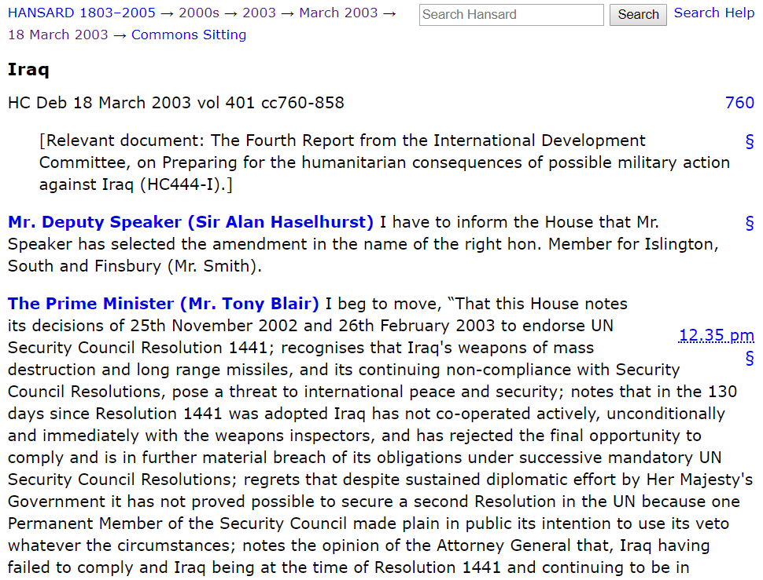
Data Scraping
Notes:
More interesting
How poorly data is represented
Wrote Python code do scrape the data and compile a database

Slide 4
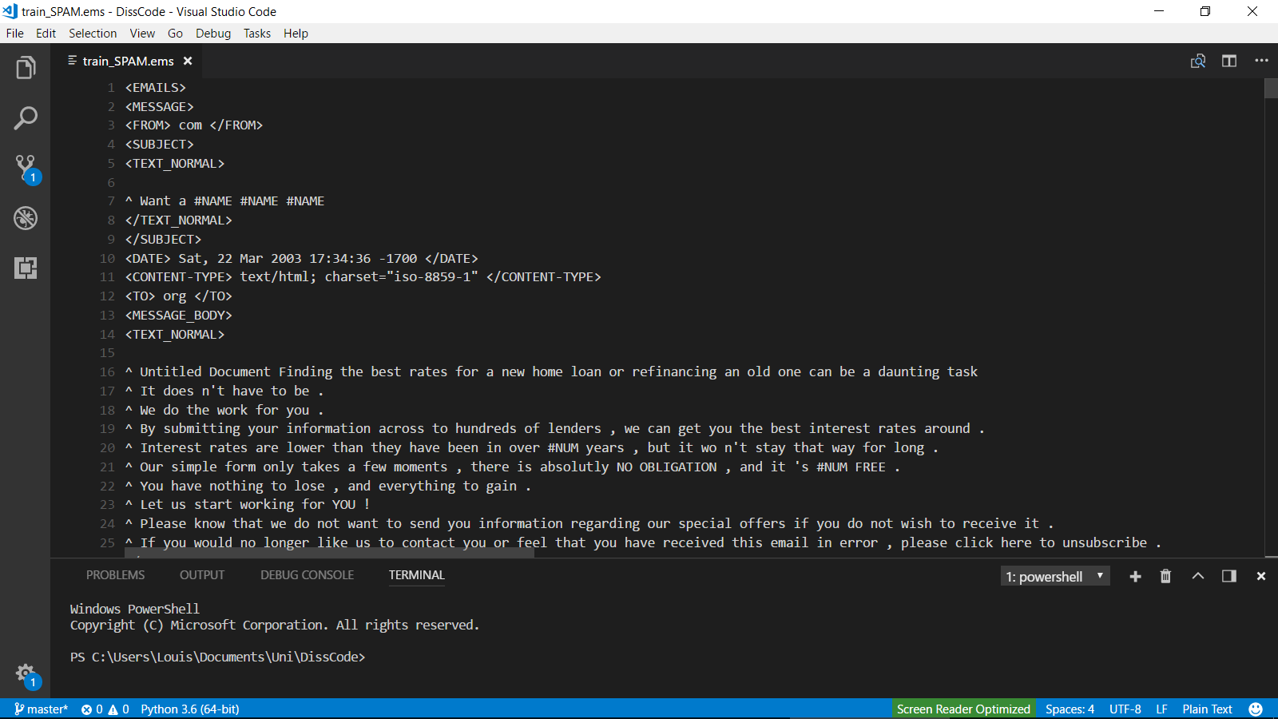
Spam Detection
Notes:
Good practice
Same problem
Good results for comparison
Used bag of words and SVM (justify)
Achieved good results, so moved on to sentiment classification of House of Commons data

Slide 5
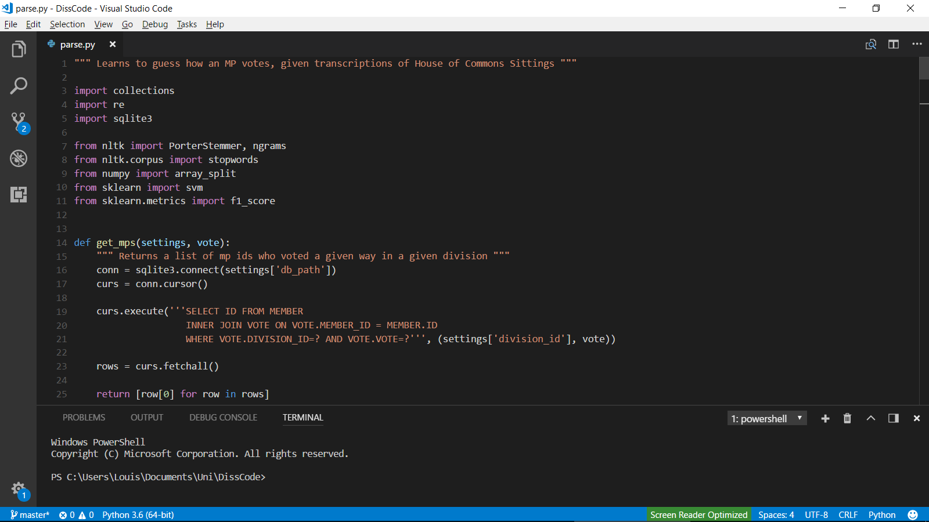
Data Analysis
Notes:
Training/test split
Surprisingly good first results
Now improving
How behind am I?

